Slide 1


Database Systems
Lecture 12
1
Types of Joins
Database Management Systems

Slide 2
Today’s agenda(Joins in database)
2
🠶Natural Join
🠶Inner Join
🠶Equi Join
🠶Theta Join
🠶Semi Join
🠶Anti Join
🠶Cross Join
🠶Outer Join
🠶 Left Outer Join
🠶 Right Outer Join
🠶 Full Outer Join
🠶Self Join
Database Management Systems

Slide 3
Join
🠶 Join is a special form of cross product of two tables.
🠶 In Cartesian product we join a tuple of one table with the tuples of the second table. But in join there is a special requirement of relationship between tuples.
🠶 For example if there is a relation STUDENT and a relation BOOK then it may be required to know that how many books have been issued to any particular student. Now in this case the primary key of STUDENT that is stId is a foreign key in BOOK table through which the join can be made.

Slide 4
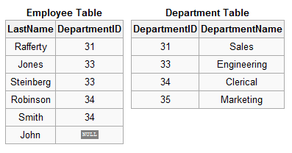

Slide 5
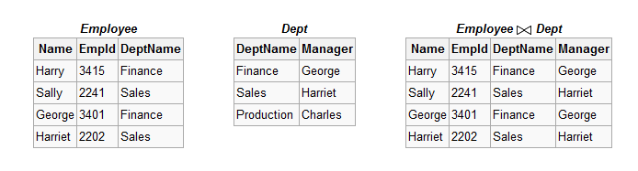
Natural Join
🠶 Natural join ( ) is a binary operator that is written as (R S) where R and S are relations.
🠶 In particular, natural join allows the combination of relations that
are associated by a foreign key.

Slide 6

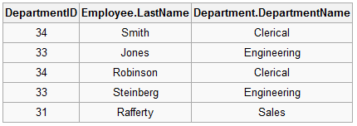
Natural Join (Example)

Slide 7


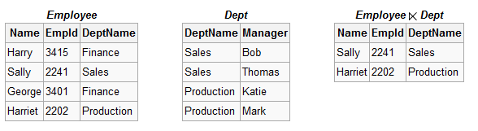
Semi Join ( ) and ( )
🠶 The left semijoin is joining similar to the natural join and written as R where R and S are relation.
S
🠶 The result of this semijoin is only the set of all tuples in R for which there is a tuple in S that is equal on their common attribute names.
🠶 For an example consider the tables Employee and Dept and their semi join:

Slide 8
Semi Join (Example)
SELECT * FROM departments WHERE EXISTS
(SELECT * FROM employees WHERE departments.department_id =
employees.department_id AND employees.salary > 2500)
ORDER BY department_name;

Slide 9
Outer Join
🠶 An outer join does not require each record in the two joined tables to have a matching record. The joined table retains each record—even if no other matching record exists. Outer joins subdivide further into left outer joins, right outer joins, and full outer joins, depending on which table(s) one retains the rows from (left, right, or both).

Slide 10
Left Outer Join
🠶 The result of a left outer join (or simply left join) for table A and B always contains all records of the "left" table (A), even if the join-condition does not find any matching record in the "right" table (B).
🠶 This means that if the ON clause matches 0 (zero) records in B, the join will still return a row in the result—but with NULL in each column from B.
🠶 This means that a left outer join returns all the values from the left table, plus matched values from the right table (or NULL in case of no matching join predicate).
🠶 If the right table returns one row and the left table returns more than one matching row for it, the values in the right table will be repeated for each distinct row on the left table.

Slide 11
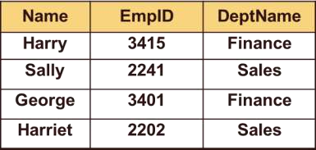
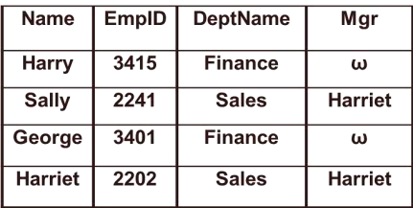

Employee
Employee =X Dept
Dept

Slide 12

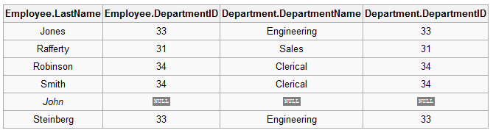
Left Outer Join (Example)

Slide 13
Right Outer Join
🠶 A right outer join (or right join) closely resembles a left outer join, except with the treatment of the tables reversed. Every row from the "right" table
(B) will appear in the joined table at least once. If no matching row from the "left" table (A) exists, NULL will appear in columns from A for those records that have no match in B. A right outer join returns all the values from the right table and matched values from the left table (NULL in case of no matching join predicate).

Slide 14
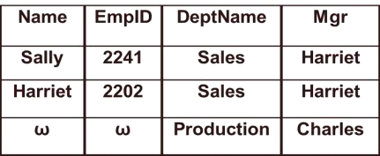
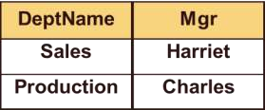
Employee
Employee X= Dept
Dept

Slide 15

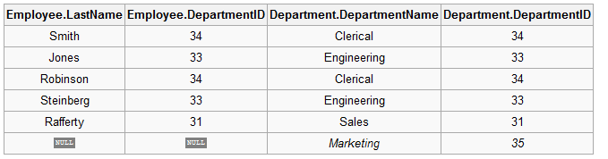
Right Outer Join (Example)

Slide 16
Full Outer Join
🠶 Conceptually, a full outer join combines the effect of applying both left and right outer joins. Where records in the FULL OUTER JOINed tables do not match, the result set will have NULL values for every column of the table that lacks a matching row. For those records that do match, a single row will be produced in the result set (containing fields populated from both tables).

Slide 17
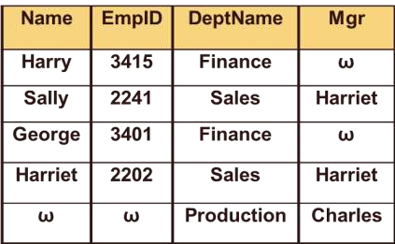
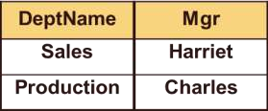
Employee
Employee =X= Dept
Dept

Slide 18

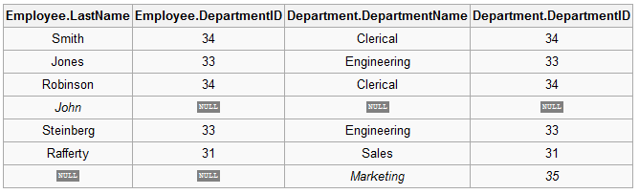
Full Outer Join (Example)

Slide 19
Cartesian Product
🠶 In mathematics, it is a set of all pairs of elements (x, y) that can be constructed from given sets, X and Y, such that x belongs to X and y to Y.
🠶 It defines a relation that is the concatenation of every tuple of relation R
with every tuple of relation S.

Slide 20
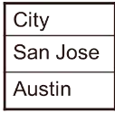
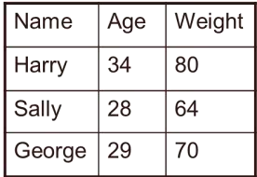
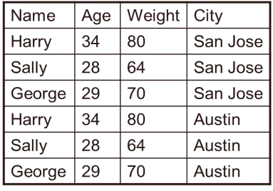
Person
City
Person X City

Slide 21
Inner join
🠶 An inner join is the most common join operation used in applications and can be regarded as the default join-type.
🠶 Inner join creates a new result table by combining column values of
two tables (A and B) based upon the join-predicate.
🠶 The query compares each row of A with each row of B to find all pairs of rows which satisfy the join-predicate. When the join- predicate is satisfied, column values for each matched pair of rows of A and B are combined into a result row.

Slide 22
Equijoin
🠶 An equi-join, also known as an equijoin, is a specific type of comparator-based join, or theta join, that uses
only equality comparisons in the join-predicate. Using other
comparison operators (such as <) disqualifies a join as an equi-join.

Slide 23
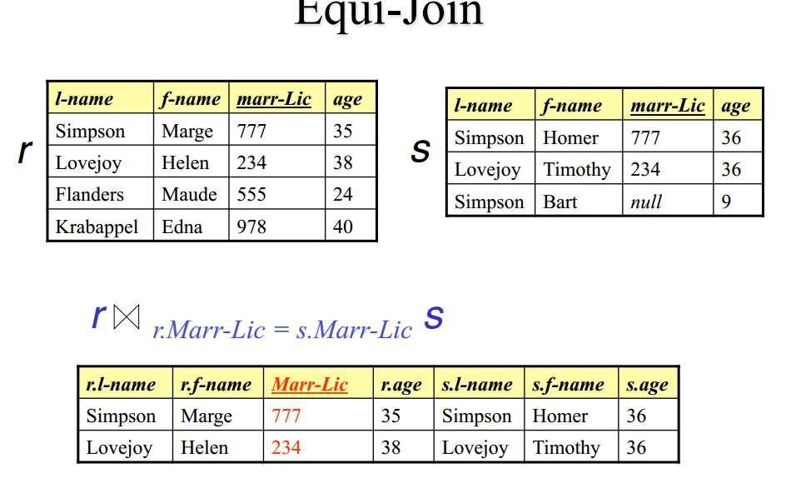

Slide 24


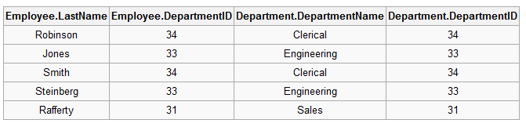
Equijoin (Example)

Slide 25
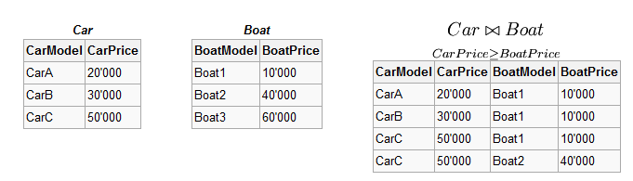
θ-join
🠶 Consider tables Car and Boat which list models of cars and boats and their respective prices.
🠶 Suppose a customer wants to buy a car and a boat, but she does not
want to spend more money for the boat than for the car.
🠶 The θ-join on the relation CarPrice ≥ BoatPrice produces a table with all the possible options. If you are using a condition where the attributes are equal the like Price the condition may be specified as Price=Price or alternatively (Price) itself.

Slide 26
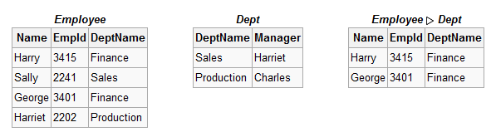
Antijoin( )
🠶 The antijoin, written as R S where R and S are relations, is similar to the natural join, but the result of an antijoin is only those tuples in R for which there is no tuple in S that is equal on their common attribute names.
🠶 For an example consider the tables Employee and Dept and their antijoin:

Slide 27
Anti Join (Example)
🠶 SELECT * FROM employees WHERE department_id NOT IN
(SELECT department_id FROM
ORDER BY last_name;
departments WHERE location_id = 1700)

Slide 28
Self Join
🠶 A self-join is joining a table to itself. This is best illustrated by an example.
🠶 A query to find all pairings of two employees in the same country is desired.
If there were two separate tables for employees and a query which requested employees in the first table having the same country as employees in the second table, a normal join operation could be used to find the answer table. However, all the employee information is contained within a single large table.

Slide 29
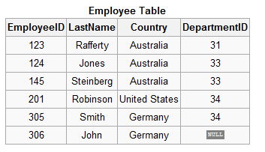
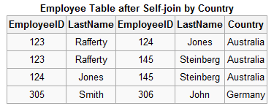

Self Join (Example)

Slide 30
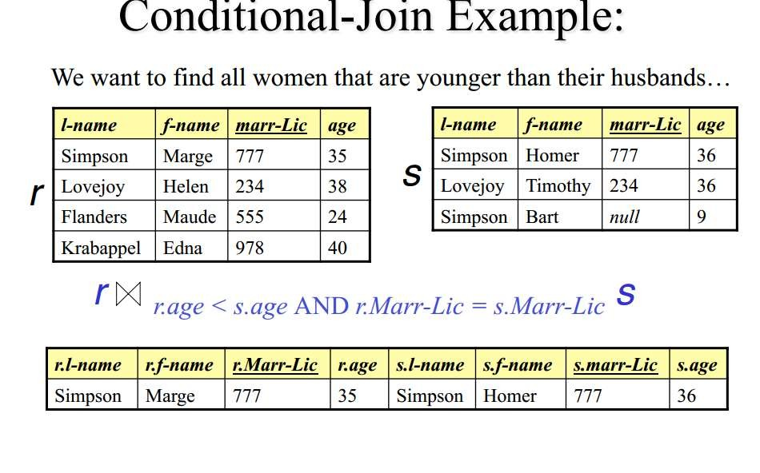

Slide 31
Query: Find the name of the sailor who reserved boat 101.

Slide 32
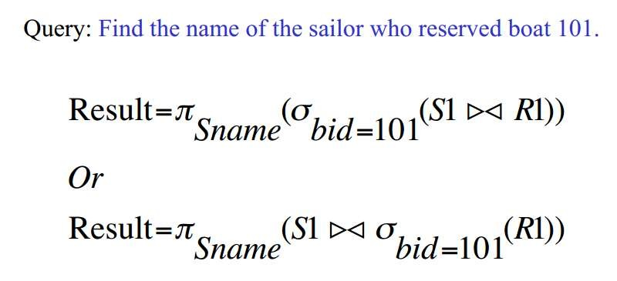
Answer

